Slide 1

Model Context Protocol
AI/ML Club

Slide 2



What is MCP?
Open-Source service to connect AI to external systems

Slide 3

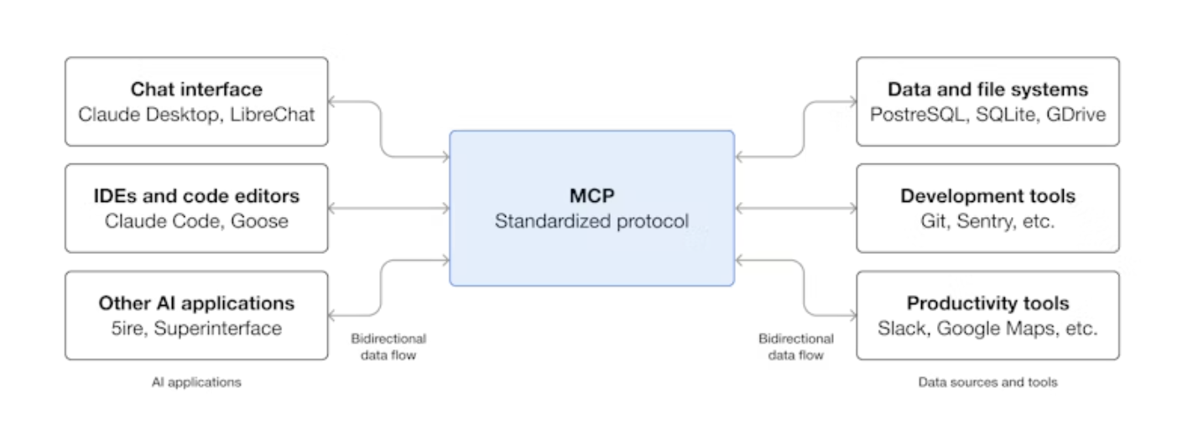
MCP Structure

Slide 4

Why MCP ?
Reduces development time by easing complexity
Access to many third party or external applications (AI agents, google services, email, etc.)
Flexibility with client. Client is more in control during prompting
Lower hallucinations

Slide 5
Installation of MCP
Mac/Linux: curl -LsSf https://astral.sh/uv/install.sh | sh
Windows: powershell -ExecutionPolicy ByPass -c "irm https://astral.sh/uv/install.ps1 | iex"

Slide 6
Initialize
Set up the project: uv init mcp-server-demo
1
Enter the project: cd mcp-server-demo
2
Install the server: uv add "mcp[cli]“
3

Slide 7
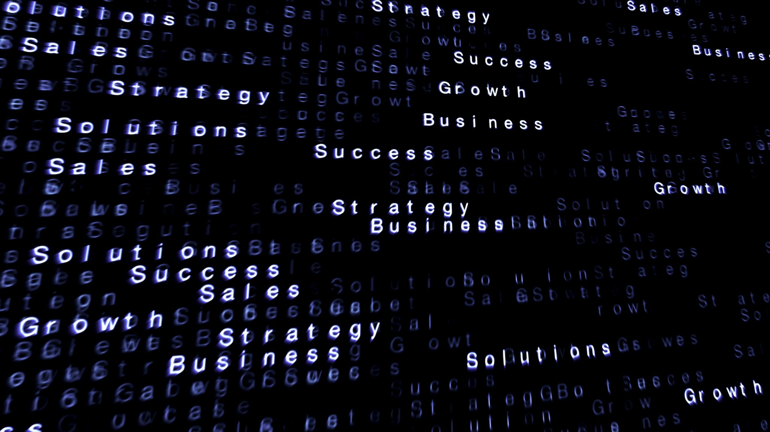
Let’s code

